Slide 1
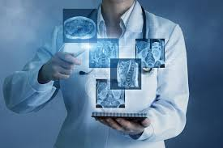
AATHI KARTHI PS
DISEASE PREDICTION USING DEEP LEARNING
3/21/2024 Annual Review

Slide 2
DISEASE PREDICTION USING DL
Disease Prediction Using Deep Learning is a pioneering approach leveraging advanced neural network technology to forecast the likelihood of various diseases based on comprehensive medical data. By analyzing diverse datasets encompassing electronic health records, medical imaging, genetic information, and lifestyle factors, this project revolutionizes healthcare diagnostics and treatment planning.
With its ability to uncover intricate patterns and subtle correlations within vast amounts of medical data, this solution empowers healthcare professionals with valuable insights for early detection, personalized medicine, and proactive intervention. By seamlessly integrating deep learning algorithms into clinical workflows, it offers the potential to revolutionize patient care, improve outcomes, and reduce healthcare costs.
3/21/2024 Annual Review

Slide 3


AGENDA
PROJECT TITLE
AGENDA
PROBLEM STATEMENT
PROJECT OVERVIEW
WHO ARE THE END USER
YOUR SOLUTION AND VALUE PROPOSITION
THE WOW IN YOUR SOLUTION
MODELLING
RESULTS
3/21/2024 Annual Review

Slide 4

PROBLEM STATEMENT
In the realm of healthcare diagnostics and prognostics, predicting diseases accurately is paramount for effective treatment and management. However, traditional methods often fall short in harnessing the full potential of available medical data, leading to missed opportunities for early detection and intervention. Our solution revolutionizes disease prediction by harnessing the power of deep learning algorithms to analyze vast and diverse datasets, including electronic health records, medical imaging, genetic information, and lifestyle factors.
By leveraging cutting-edge neural network technology, our project uncovers hidden patterns and subtle correlations within complex medical data, enabling more accurate and timely predictions of various diseases. From identifying individuals at high risk for chronic conditions to predicting the progression of degenerative diseases, our solution empowers healthcare professionals with actionable insights for proactive patient care and personalized treatment strategies.
3/21/2024 Annual Review

Slide 5

PROJECT OVERVIEW
Our project revolves around Disease Prediction Using Deep Learning, employing advanced neural network technology to forecast various diseases based on comprehensive medical data. The primary objective is to develop an innovative solution that enhances healthcare diagnostics and treatment planning by leveraging the power of deep learning algorithms.
By analyzing diverse datasets encompassing electronic health records, medical imaging, genetic information, and lifestyle factors, we aim to provide healthcare professionals with valuable insights for early detection, personalized medicine, and proactive intervention. The project's significance lies in its potential to revolutionize patient care, improve outcomes, and reduce healthcare costs by seamlessly integrating deep learning into clinical workflows.
3/21/2024 Annual Review

Slide 6

WHO ARE THE END USERS?
Various stakeholders across different sectors can benefit from our Disease Prediction Using Deep Learning solution. These entities may utilize the system to:
Improve healthcare outcomes: Healthcare providers can utilize disease prediction models to identify individuals at high risk for various conditions, enabling early intervention and preventive care strategies.
Optimize resource allocation: Hospitals and healthcare facilities can use predictive analytics to allocate resources more efficiently, such as staffing, equipment, and medications, based on predicted disease prevalence and patient needs.
Enhance research and development: Pharmaceutical companies and research institutions can leverage disease prediction models to identify potential targets for drug development, prioritize research efforts, and accelerate the discovery of new treatments.
3/21/2024 Annual Review

Slide 7
YOUR SOLUTION AND ITS VALUE PROPOSITION
Automated Prediction: Our Disease Prediction Using Deep Learning solution harnesses state-of-the-art neural network technology to automatically forecast various diseases based on comprehensive medical data, eliminating the need for manual prediction efforts.
Efficiency & Precision: By automating the disease prediction process, our system saves time and resources while ensuring precise and timely forecasts, optimizing healthcare delivery and patient outcomes.
Improved Healthcare Decision-making: By seamlessly integrating deep learning algorithms into clinical workflows, our solution empowers healthcare professionals with valuable insights for early detection, personalized treatment planning, and proactive patient care, revolutionizing healthcare decision-making processes.
3/21/2024 Annual Review

Slide 8

THE WOW IN YOUR SOLUTION
Real-Time Prediction: Our Disease Prediction Using Deep Learning solution offers real-time forecasts of various diseases, providing immediate insights to healthcare professionals.
High Precision: Utilizing advanced neural network technology, our system delivers accurate disease predictions, minimizing false positives and negatives in the prognostic results.
User-Friendly Interface: Engineered for usability, our system boasts an intuitive interface that caters to users of all proficiency levels. With features like interactive visualizations, customizable prediction settings, and seamless integration into existing healthcare systems, it ensures a smooth and efficient user experience..
3/21/2024 Annual Review
8

Slide 9
MODELLING
Modeling Process:
Data Collection
Preprocessing
Model Selection
Training
Evaluation
Optimization
Deployment
3/21/2024 Annual Review
9

Slide 10
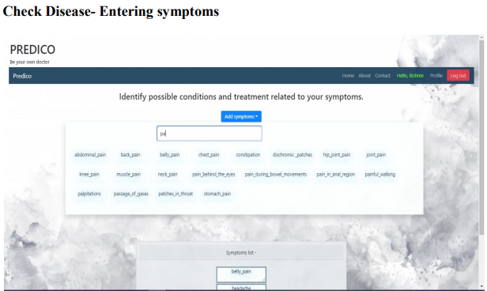
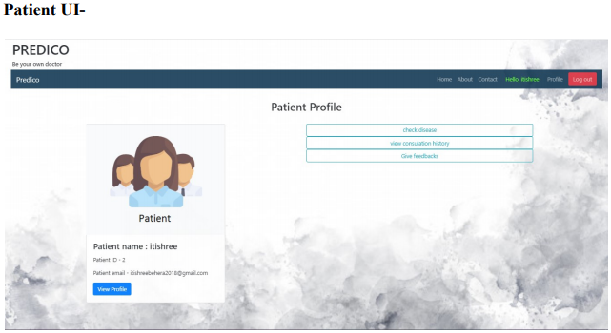
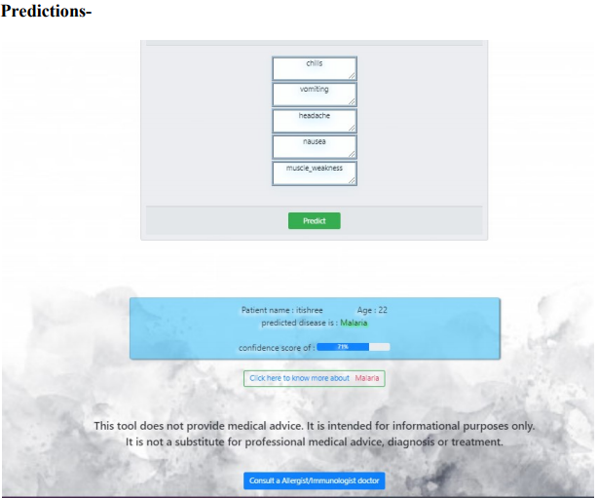
RESULTS
Output Images
3/21/2024 Annual Review
10

